Slide 1
Local Image Features
Computer Vision
Dr. Abdul Basit
Assitant Profosser - CSIM University of Balochistan
October 16, 2015
Dr. Abdul Basit (CSIT - UoB)
Local Image Features
October 16, 2015
1 / 4

Slide 2

Contents
1 Overview of keypoint Matching (Harris Corners)
Dr. Abdul Basit (CSIT - UoB)
Local Image Features
October 16, 2015
2 / 4

Slide 3
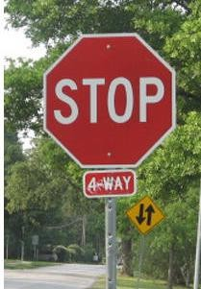



This section: correspondence and alignment
Correspondence: matching points, patches, edges, or regions across images
≈

Slide 4







Overview of Keypoint Matching
1. Find a set of distinctive key-points
A₁
2. Define a region around each keypoint
A₂
A₃
Extract and normalize the region content
Compute a local descriptor from the normalized region
f
f
A
B
d( f _{A} , f_{B} ) < T
5. Match local descriptors
K. Grauman, B. Leibe

Slide 5

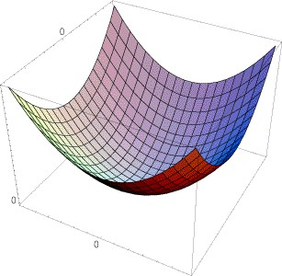
Review: Harris corner detector
E(u, v)
Approximate distinctiveness by local auto-correlation.
Approximate local auto-correlation by second moment matrix
Quantify distinctiveness (or cornerness) as function of the eigenvalues of the second moment matrix.
But we don’t actually need to compute the eigenvalues by using the determinant and trace of the second moment matrix.
(λ
₎-1/2
max
(λ
₎-1/2
min

Slide 6
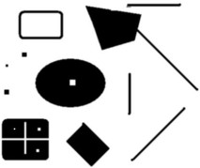
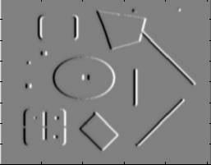
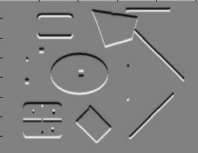
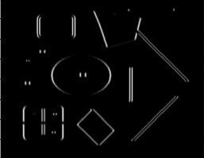
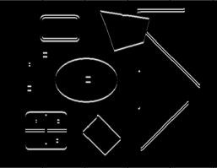
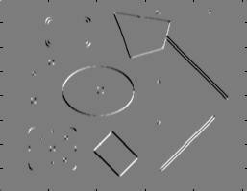
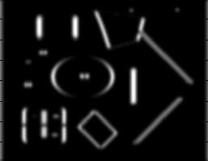
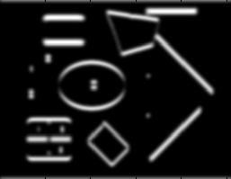
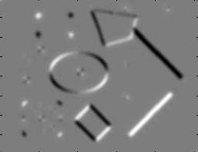
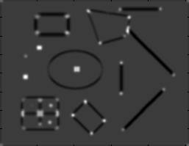
Harris Detector [Harris88]
Second moment matrix
⎡
2
σ ) I I (σ
)⎤
I (
1. Image
derivatives
(optionally, blur first)
I_{x}
I_{y}
μ(σ ,σ
) = g(σ ) ∗ ⎢
x D x y D
⎥
I D
I
⎣⎢I I (σ ) I (
σ ) ⎥⎦
2
x y D
y D
I_{x}
2
I_{y}
2
I_{x}I_{y}
2. Square of derivatives
det M = λλ
1 2
trace M = λ₁ + λ₂
g(I I )
g(I_{x} )
g(I_{y} )
3. Gaussian filter g(σ_{I})
2
2
x y
4. Cornerness function – both eigenvalues are strong
har = det[μ(σ ,σ )] −α[trace(μ(σ ,σ ))² ] =
I D I D
g(I )g(I ) −[g(I I )] −α[g(I ) +
2 2
2
2
2 2
g(I )]
x y x y
x
y
5. Non-maxima suppression
har
5

Slide 7
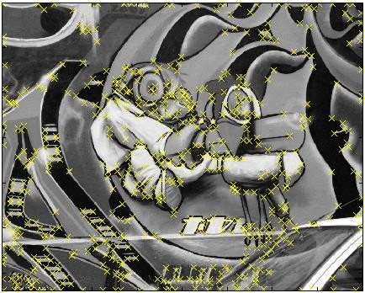
So far: can localize in x-y, but not scale

Slide 8
SIFT - Key Point Extraction
Stands for scale invariant feature transform
Patented by university of British Columbia
Similar to the one used in primate visual system (human, ape, monkey, etc.)
Transforms image data into scale-invariant coordinates
D. Lowe. Distinctive image features from scale-invariant key points., International Journal of Computer Vision 2004.

Slide 9
Goal
Extracting distinctive invariant features
Correctly matched against a large database of features from many images
Invariance to image scale and rotation
Robustness to
Affine distortion,
Change in 3D viewpoint,
Addition of noise,
Change in illumination.

Slide 10
Advantages
Locality: features are local, so robust to occlusion and clutter
Distinctiveness: individual features can be matched to a large database of objects
Quantity: many features can be generated for even small objects
Efficiency: close to real-time performance

Slide 11
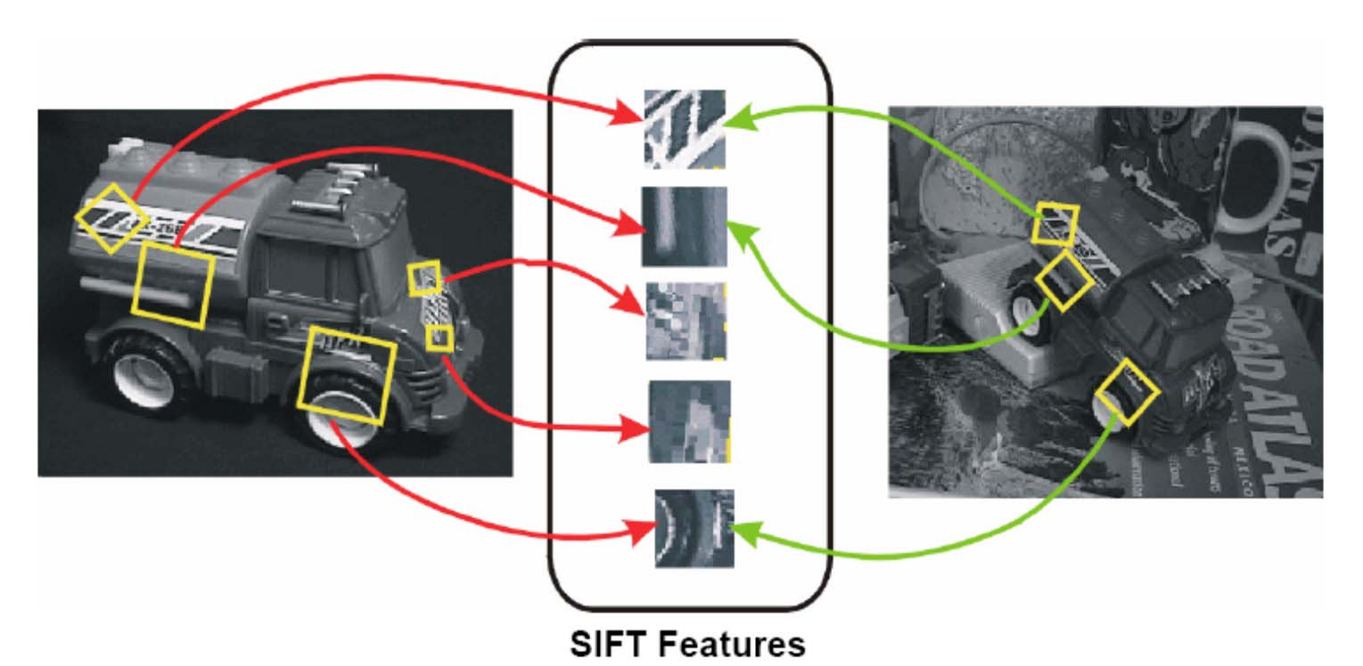
Invariant Local Features

Slide 12
Steps for Extracting Key Points
Scale space peak selection
Potential locations for finding features
Key point localization
Accurately locating the feature key points
Orientation Assignment
Assigning orientation to the key points
Key point descriptor
Describing the key point as a high dimensional vector

Slide 13
Scales
What should be sigma value for Canny and LG edge detection?
If use multiple sigma values (scales), how do you combine multiple edge maps?
Marr-Hildreth:
Spatial Coincidence assumption:
Zerocrossings that coincide over several scales are physically significant.

Slide 14
Scale Space (Witkin, IJCAI
1983)
Apply whole spectrum of scales
Plot zerocrossings vs scales in a scale-space

Slide 15
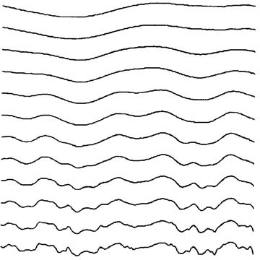
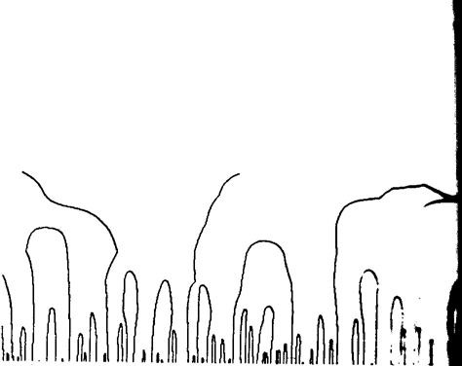
Scale Space
scale
scale
Multiple smooth versions of a signal
Zerocrossings at multiple scale

Slide 16
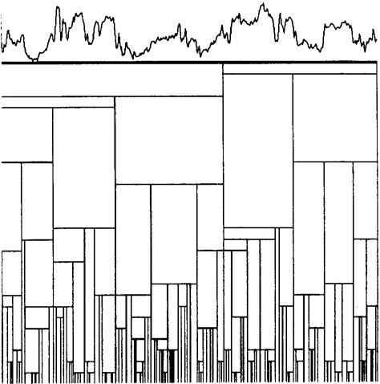
Scale Space
Scale Space
Interval Tree

Slide 17
Scale Space (Witkin, IJCAI
1983)
Apply whole spectrum of scales
Plot zerocrossings vs scales in a scale-space
Interpret scale space contours
Contours are arches, open at the bottom, closed at the top
Interval tree
Each interval corresponds to a node in a tree, whose parent node represents larger interval, from which interval emerged, and whose off springs represent smaller intervals.
Stability of a node is a scale range over which the interval exits.

Slide 18
Scale Space
Top level description
Iteratively remove nodes from the tree, splicing out nodes that are less stable than any of their parents and off springs

Slide 19
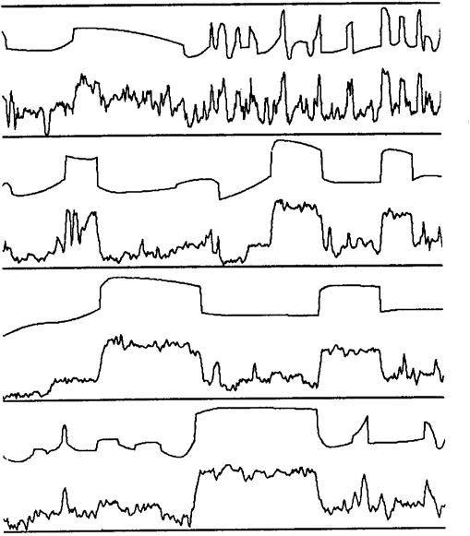
Scale Space
A top level description of several signals using stability criterion.

Slide 20
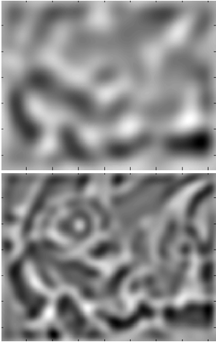
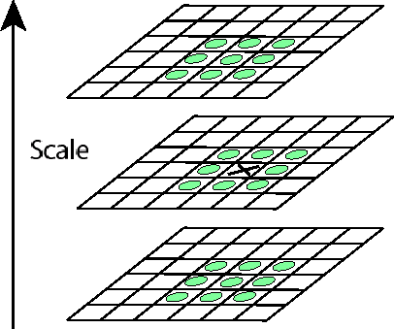

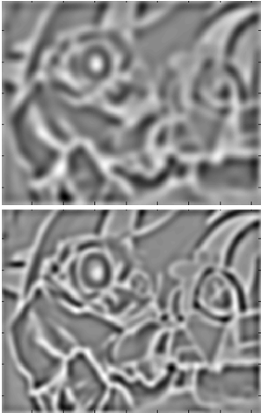
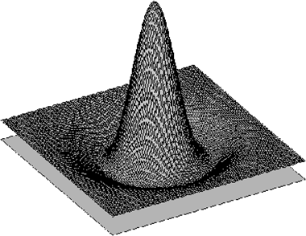
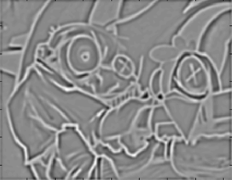
Laplacian-of-Gaussian (LoG)
Interest points:
_{σ}5
Local maxima in scale space of Laplacian-of-Gaussian
Perceptual and Sensory Augmented Computing
_{σ}4
Visual Object Recognition Tutorial
L_{xx} (σ ) + L_{yy} (σ )
_{σ}3
_{σ}2
⇒ List of
(x, y, σ)
σ
K. Grauman, B. Leibe

Slide 21
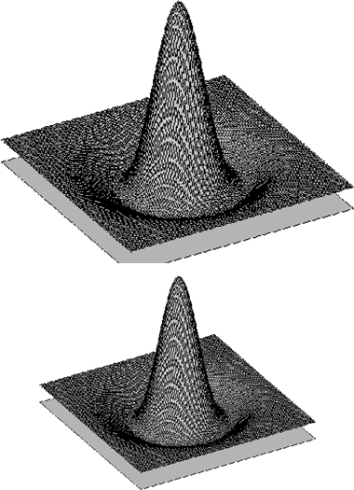






What Is A Useful Signature Function?
Laplacian-of-Gaussian = “blob” detector
Perceptual and Sensory Augmented Computing
Visual Object Recognition Tutorial
Visual Object Recognition Tutorial
K. Grauman, B. Leibe

Slide 22
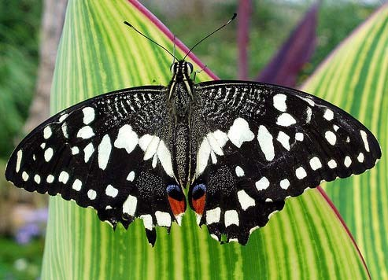
Scale-space blob detector: Example
Source: Lana Lazebnik

Slide 23
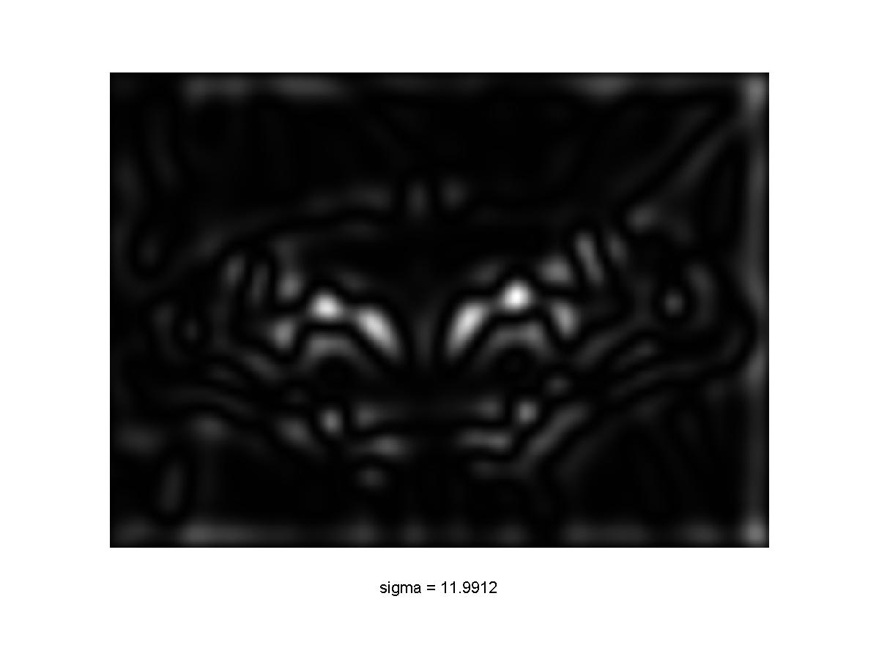
Scale-space blob detector: Example
Source: Lana Lazebnik

Slide 24
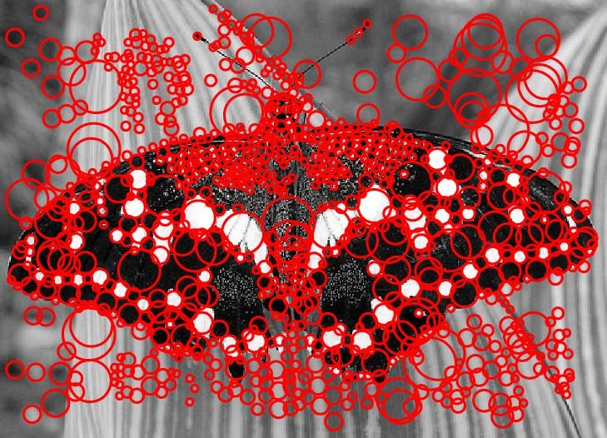
Scale-space blob detector: Example
Source: Lana Lazebnik

Slide 25
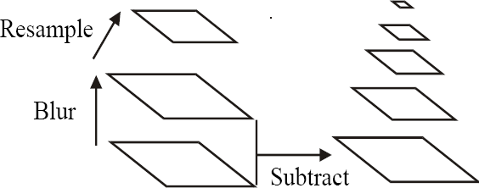
Building a Scale Space
All scales must be examined to identify scale-invariant features
An efficient function is to compute the Laplacian Pyramid (Difference of Gaussian) (Burt & Adelson, 1983)

Slide 26
Approximation of LoG by Difference of Gaussians
^{∂G} = σΔ²G
∂σ
Heat Equation
_{σΔ2G =} ∂G ₌ G(x, y, kσ ) − G(x, y,σ )
∂σ kσ − σ
G(x, y, kσ ) − G(x, y,σ ) ≈ (k −1)σ ²Δ²G
Typical values:σ = 1.6; k = 2

Slide 27
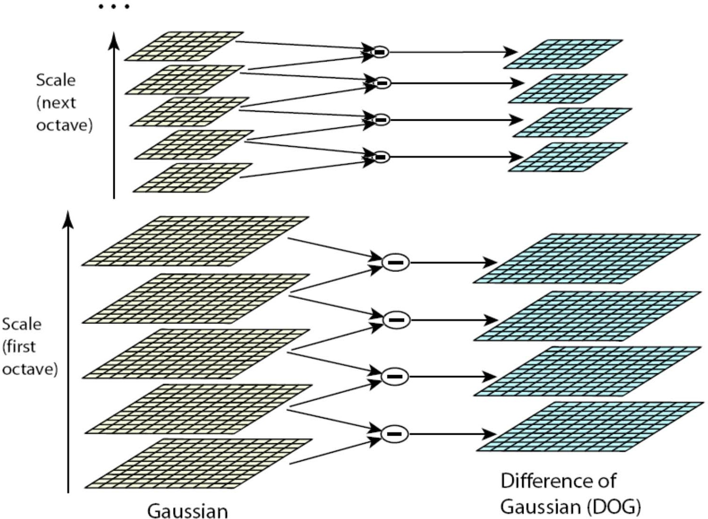
Building a Scale Space
1
2π ( kσ )²
_{e}−( x² + y ² ) / 2 k ²σ ²
G( x, y,kσ ) =
k = 2

Slide 28
Building a Scale Space
1
2π ( kσ )²
_{e}−( x² + y ² ) / 2 k ²σ ²
G( x, y,kσ ) =
k ⁴σ
k ³σ
k ²σ
k ⁴σ
k ³σ
k ²σ
kσ
σ
k = 2

Slide 29

σ = .707187.6; k = 2

Slide 30
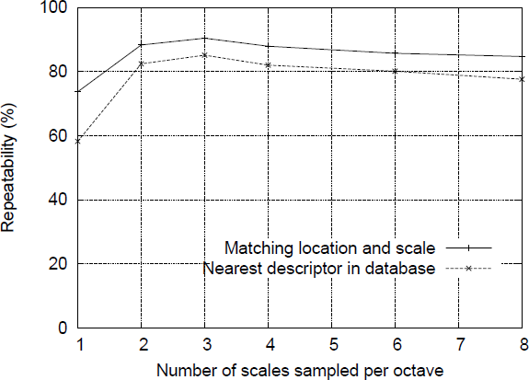
How many scales per octave?

Slide 31
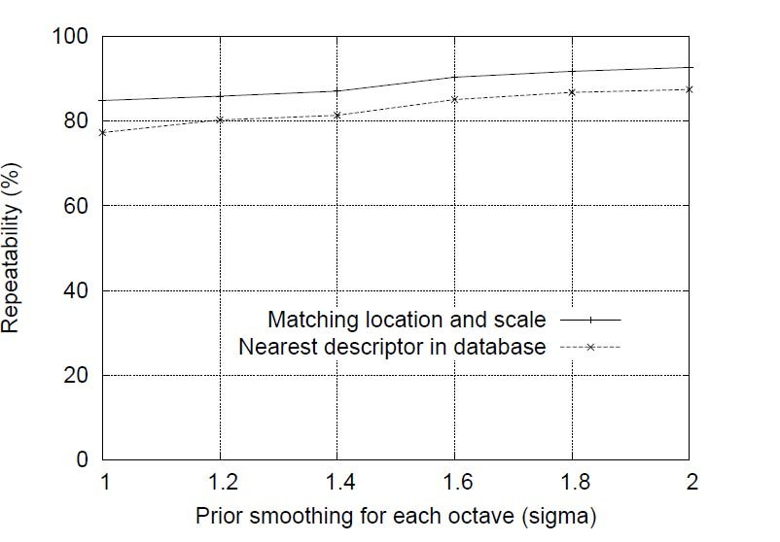
Initial value of sigma

Slide 32
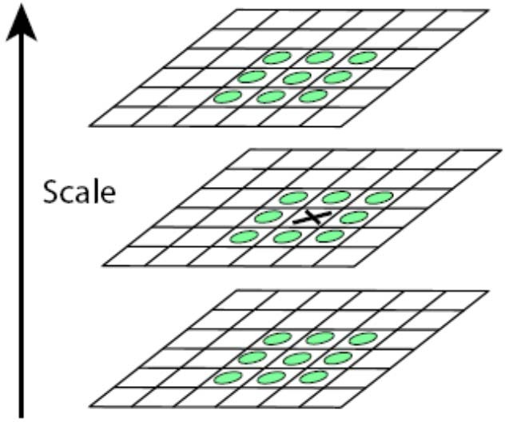
Scale Space Peak Detection
Compare a pixel (X) with 26 pixels in current and adjacent scales (Green Circles)
Select a pixel (X) if larger/smaller than all 26 pixels
Large number of extrema, computationally expensive
Detect the most stable subset with a coarse sampling of scales

Slide 33
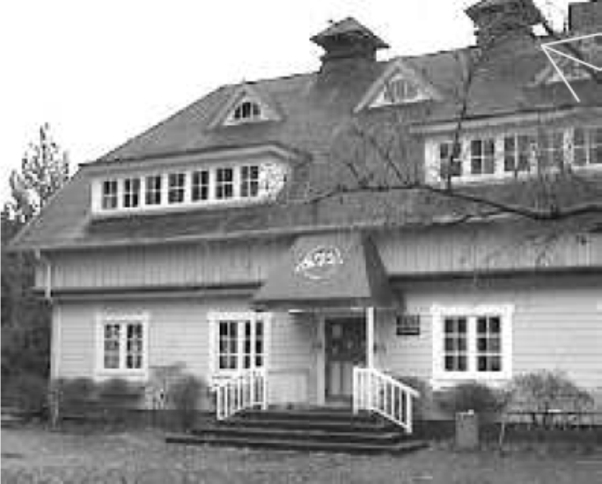
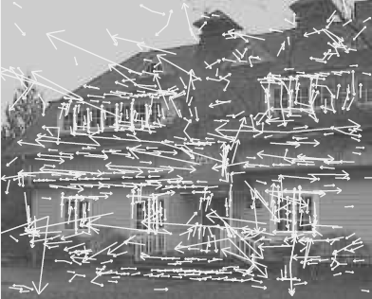
Key Point Localization
Candidates are chosen from extrema detection
original image
extrema locations

Slide 34





Initial Outlier Rejection
Low contrast candidates
2 Poorly localized candidates along an edge
Taylor series expansion of DOG, D.
_{I) +} •›l) '
I›:x )
X
//x
)y-
Minima or maxima is located at
Value of D(x} at minima/maxima must be
« = — ,
›,- •›x
large, |D(x)|»ih.
“

Slide 35
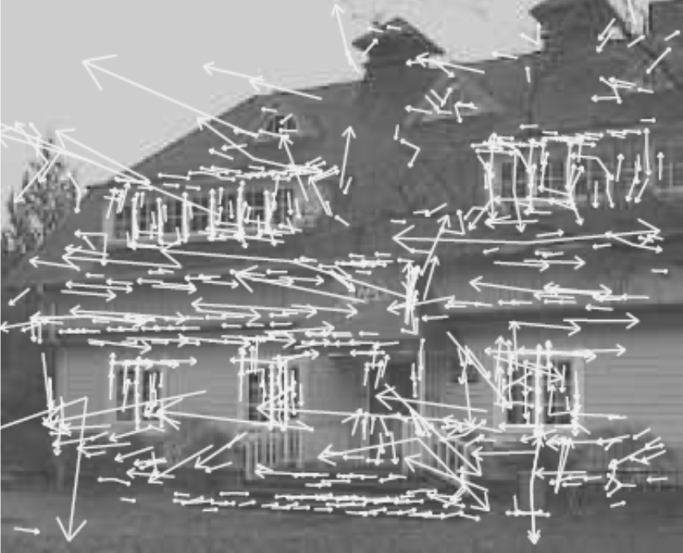
Initial Outlier Rejection
from 832 key points to 729 key points, th=0.03.

Slide 36
Further Outlier Rejection
DOG has strong response along edge
Assume DOG as a surface
Compute principal curvatures (PC)
Along the edge one of the PC is very low, across the edge is high

Slide 37

Further Outlier Rejection
Analogous to Harris corner detector
Compute Hessian of D
Tr(H ) = D_{xx} + D_{yy} =λ₁+λ₂
2
λ λ
Det(H ) = D D − (D ) =
xx yy xy
1 2
Remove outliers by evaluating
Tr(H )² ₌ (r +1)²
Det(H ) r
r = ^{λ1}
λ₂

Slide 38
Further Outlier Rejection
Following quantity is minimum when r=1
It increases with r
λ
Tr(H )² ₌ (r +1)²
Det(H ) r
Eliminate key points if
r =
1
λ₂
r > 10

Slide 39

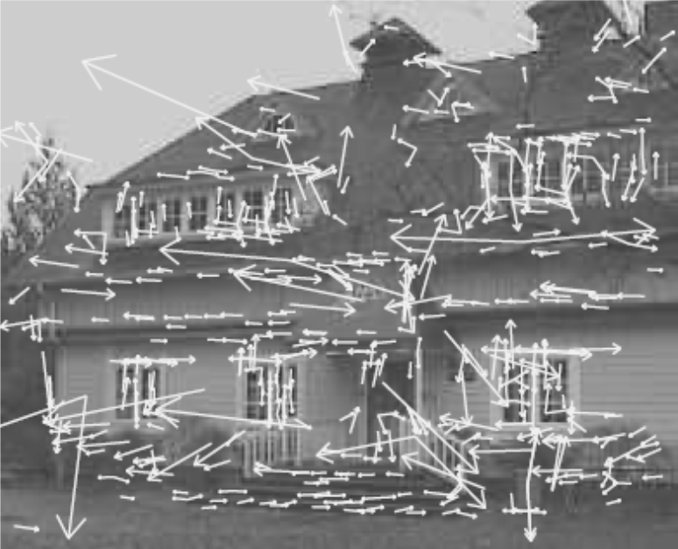
Further Outlier Rejection
from 729 key points to 536 key points.

Slide 40
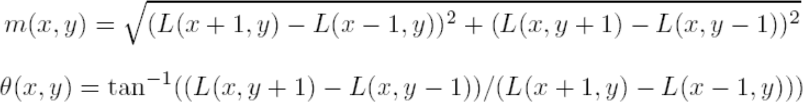
Orientation Assignment
To achieve rotation invariance
Compute central derivatives, gradient magnitude and direction of L (smooth image) at the scale of key point (x,y)

Slide 41
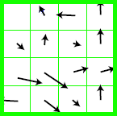
Orientation Assignment
Create a weighted direction histogram in a neighborhood of a key point (36 bins)
Weights are
Gradient magnitudes
Spatial gaussian filter with
σ=1.5 x <scale of key point>

Slide 42
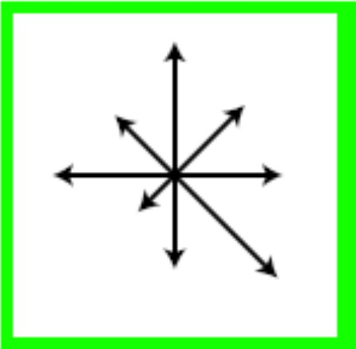
Orientation Assignment
Select the peak as direction of the key point
Introduce additional key points (same location) at local peaks (within 80% of max peak) of the histogram with different directions

Slide 43
Local Image Descriptors at Key Points
Possible descriptor
Store intensity samples in the neighborhood
Sensitive to lighting changes, 3D object transformation
Use of gradient orientation histograms
Robust representation

Slide 44
Similarity to IT cortex
Complex neurons respond to a gradient at a particular orientation.
Location of the feature can shift over a small receptive field.
Edelman, Intrator, and Poggio (1997)
The function of the cells allow for matching and recognition of 3D objects from a range of view points.
Experiments show better recognition accuracy for 3D objects rotated in depth by up to 20 degrees
39

Slide 45
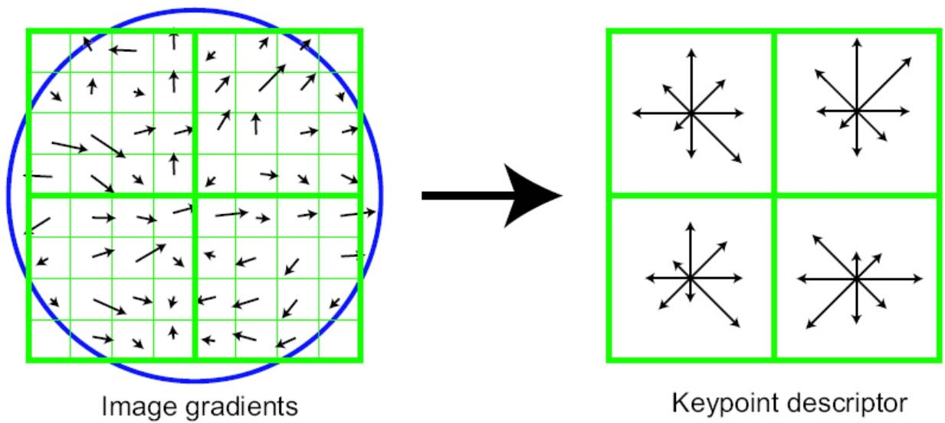
Extraction of Local Image Descriptors at Key Points
Compute relative orientation and magnitude in a 16x16 neighborhood at key point
Form weighted histogram (8 bin) for 4x4 regions
Weight by magnitude and spatial Gaussian
Concatenate 16 histograms in one long vector of 128 dimensions
Example for 8x8 to 2x2 descriptors

Slide 46
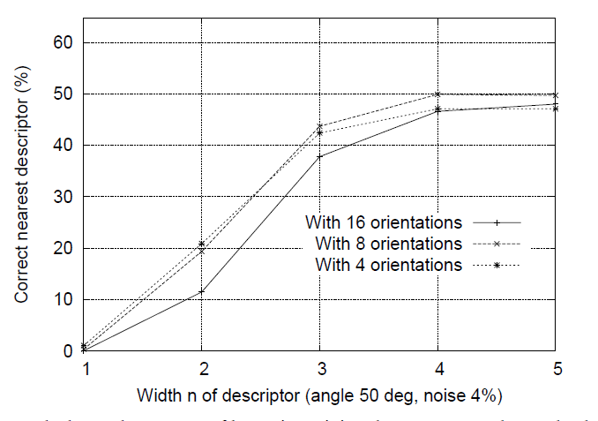
Descriptor Regions (n by n)

Slide 47
Extraction of Local Image Descriptors at Key Points
Store numbers in a vector
Normalize to unit vector (UN)
Illumination invariance (affine changes)
For non-linear intensity transforms
Bound Unit Vector items to maximum 0.2 (remove larger gradients)
Renormalize to unit vector

Slide 48
Key point matching
Match the key points against a database of that obtained from training images.
Find the nearest neighbor i.e. a key point with minimum Euclidean distance.
Efficient Nearest Neighbor matching
Looks at ratio of distance between best and 2nd best match (.8)
43

Slide 49
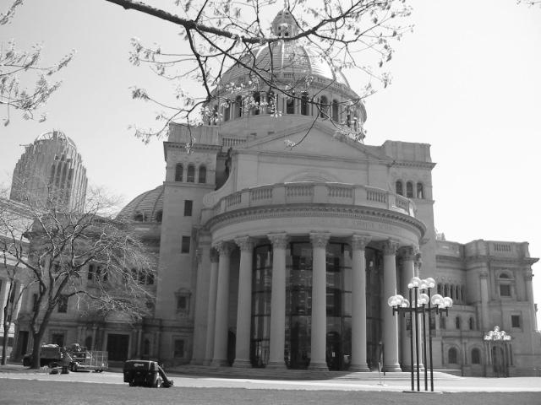
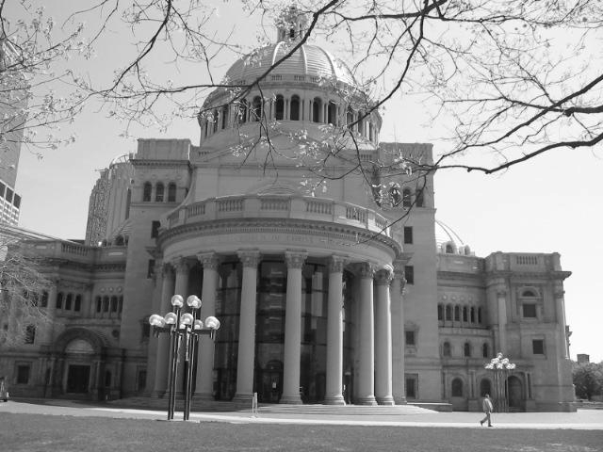
Matching local features
Kristen Grauman

Slide 50
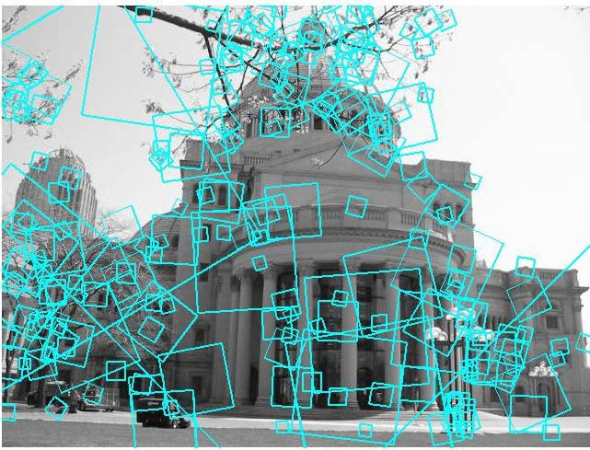
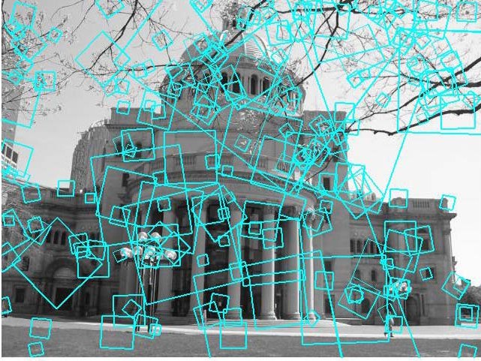
Matching local features
?
Image 1 Image 2
To generate candidate matches, find patches that have the most similar appearance or SIFT descriptor
Simplest approach: compare them all, take the closest (or closest k, or within a thresholded distance)
Kristen Grauman

Slide 51
Ambiguous matches
? ? ? ?
Image 1
At what distance do we have a good match?
To add robustness to matching, can consider ratio : distance to best match / distance to second best match
If low, first match looks good.
If high, could be ambiguous match.
Image 2
Kristen Grauman

Slide 52
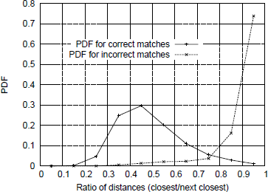
The ratio of distance
from the closest to the distance of the second closest

Slide 53
Reference
D. Lowe. Distinctive image features from scale-invariant key points., International Journal of Computer
Vision 2004.

Slide 54
The End
4 / 4

